Slide 1
A First Book of ANSI C
Fourth Edition
Chapter 5
Repetition

Slide 2
Objectives
Basic Loop Structures
The while Statement
Computing Sums and Averages Using a while Loop
The for Statement

Slide 3
Objectives (continued)
Case Studies: Loop Programming Techniques
Nested Loops
The do-while Statement
Common Programming and Compiler Errors

Slide 4
Introduction
A section of code that is repeated is called a loop, because after the last statement in the code is executed, the program branches, or loops, back to the first statement and starts another repetition through the code
Each repetition is also called an iteration or pass through the loop

Slide 5
Basic Loop Structures
Constructing a repeating section of code requires that four elements be present:
  Repetition statement
    while statement
    for statement
    do-while statement
  Condition
  A statement that initially sets the condition being tested
  A statement within the repeating section of code that alters the condition so that it eventually becomes false

Slide 6
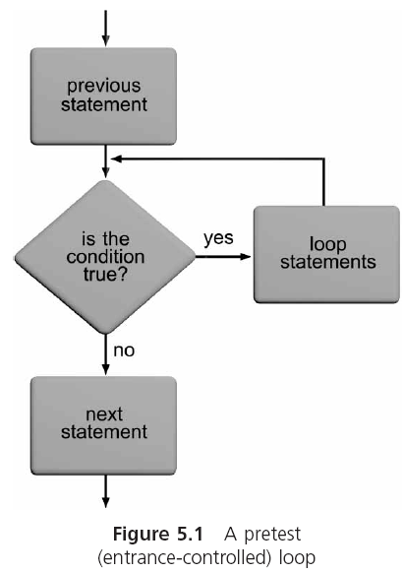
Pretest and Posttest Loops

Slide 7
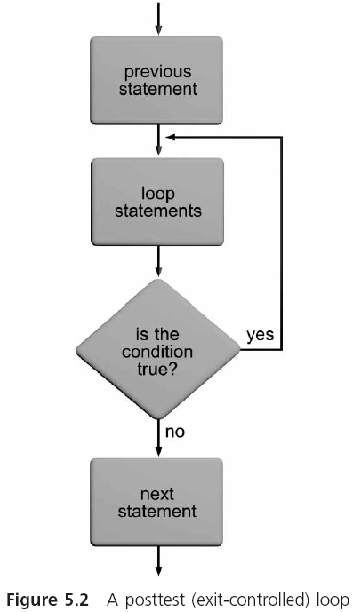
Pretest and Posttest Loops (continued)

Slide 8
Counter-Controlled and Condition-Controlled Loops
Counter-controlled loop: the condition is used to keep track of the number of repetitions
  Also known as a fixed-count loop
Condition-controlled loop: the tested condition does not depend on a count being achieved, but rather on a specific value being encountered

Slide 9
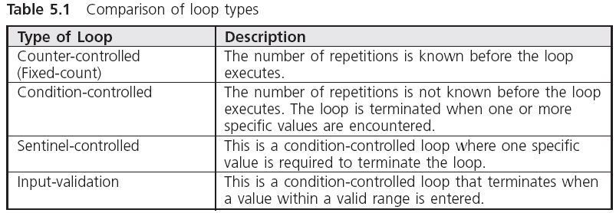
Basic Loop Structures

Slide 10
The while Statement
The general form of the while statement is
  while (expression)
  statement;
The transfer of control back to the start of a while statement to reevaluate the expression is known as a program loop
The following is a valid but infinite loop:
  while (count <= 10)
  printf("%d ",count);

Slide 11
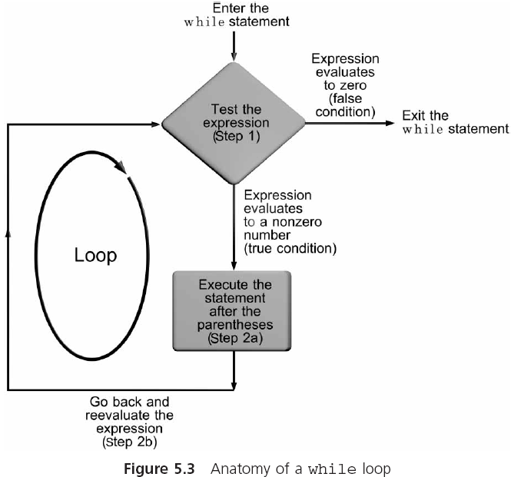
The while Statement (continued)

Slide 12
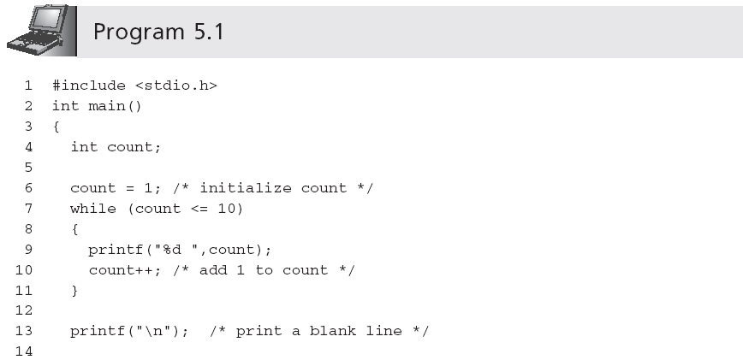
The while Statement (continued)
Output is:
1 2 3 4 5 6 7 8 9 10

Slide 13
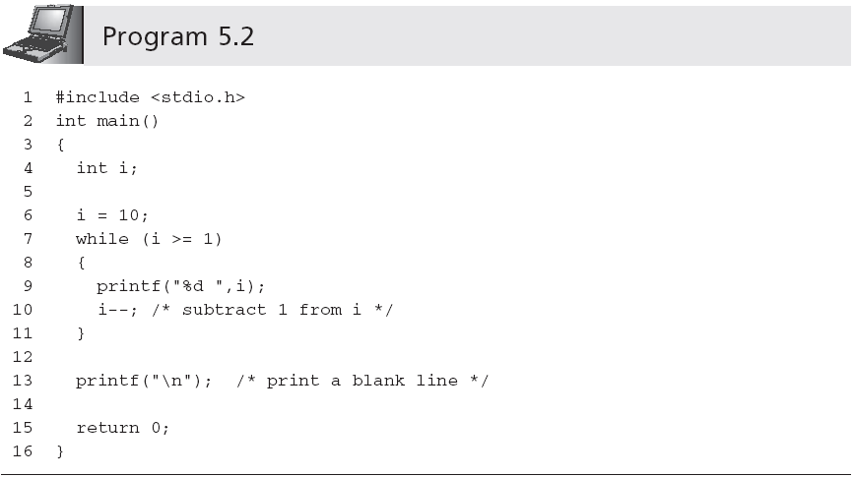
The while Statement (continued)
Output is:
10 9 8 7 6 5 4 3 2 1

Slide 14
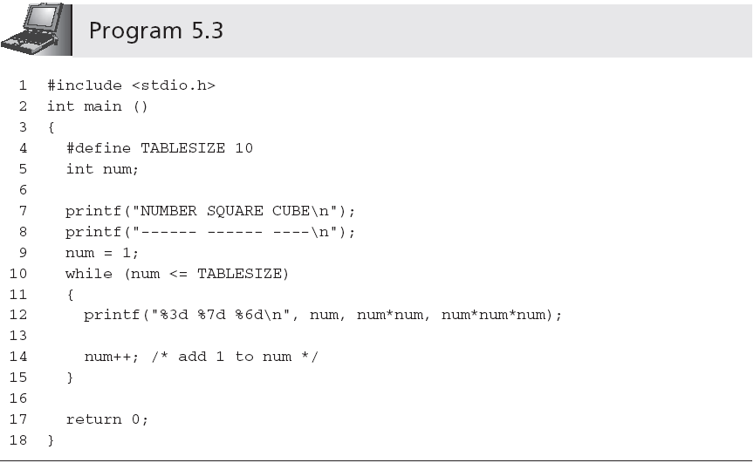
The while Statement (continued)
Output is:
NUMBER SQUARE CUBE
------ ------ ----
1 1 1
2 4 8
3 9 27
4 16 64
5 25 125
6 36 216
7 49 343
8 64 512
9 81 729
10 100 1000

Slide 15
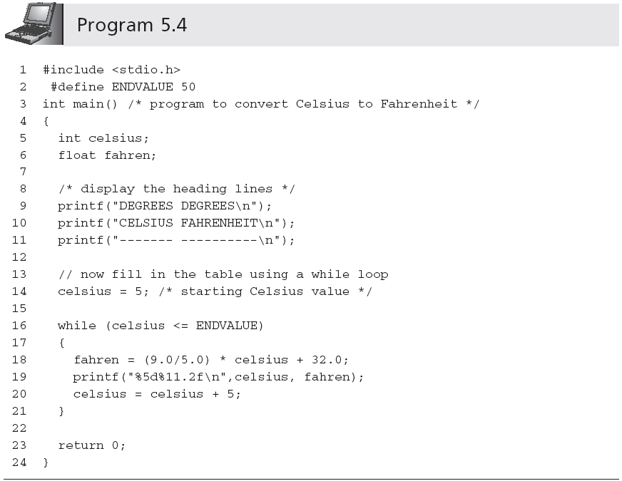
The while Statement (continued)
Condition-controlled loop
Output is:
DEGREES DEGREES
CELSIUS FAHRENHEIT
------- ----------
5 41.00
10 50.00
15 59.00
20 68.00
25 77.00
30 86.00
35 95.00
40 104.00
45 113.00
50 122.00

Slide 16
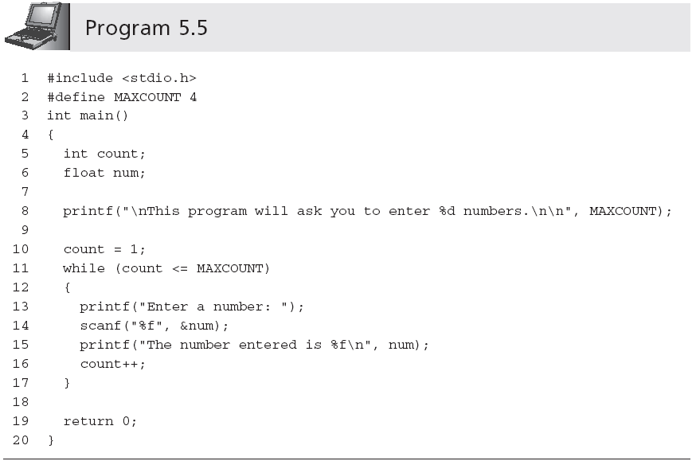
Computing Sums and Averages Using a while Loop

Slide 17
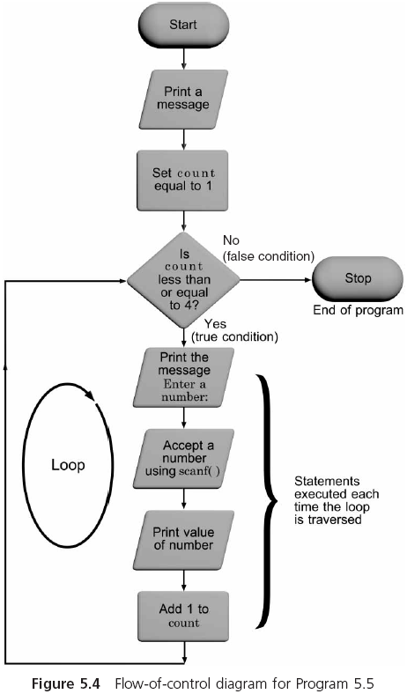
Computing Sums and Averages Using a while Loop (continued)

Slide 18
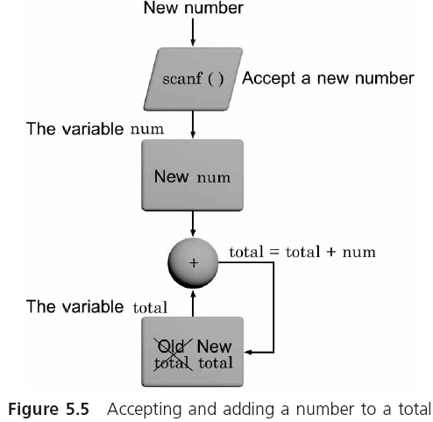
Computing Sums and Averages Using a while Loop (continued)

Slide 19
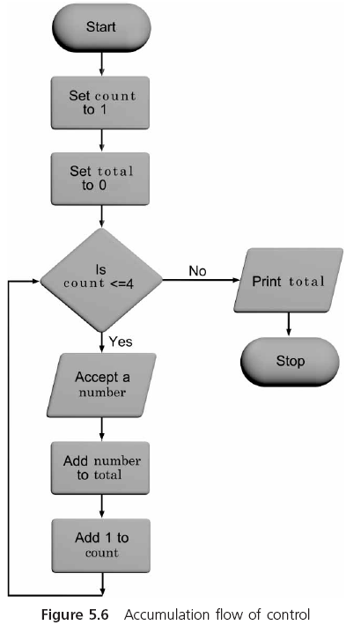
Computing Sums and Averages Using a while Loop (continued)

Slide 20
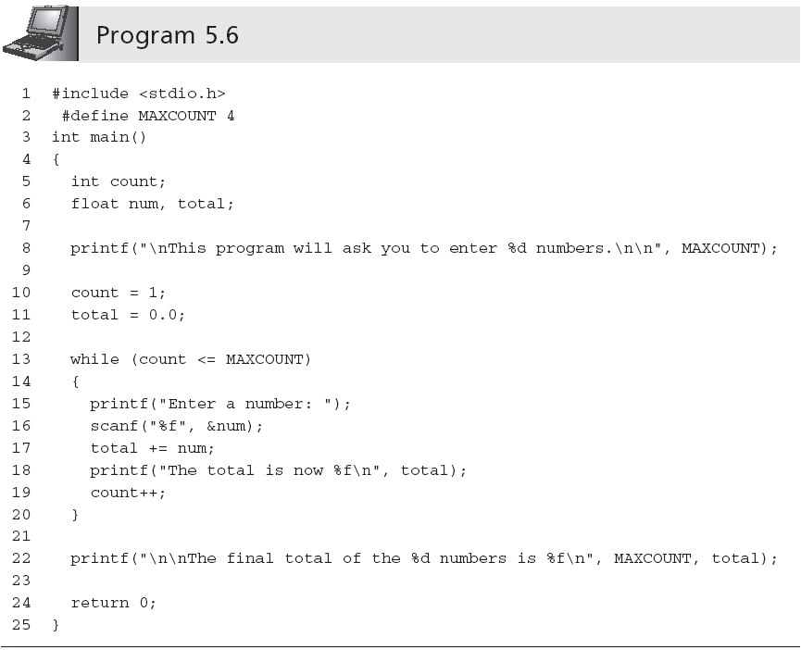
Computing Sums and Averages Using a while Loop (continued)
Ensures that any previous value present in the storage locations assigned to the variable total is overwritten and the total starts at a correct value
Accumulating statement

Slide 21
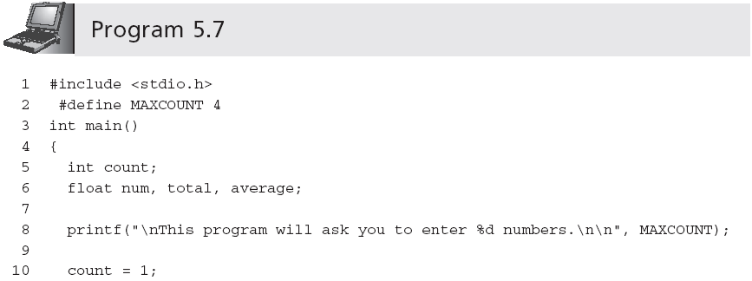
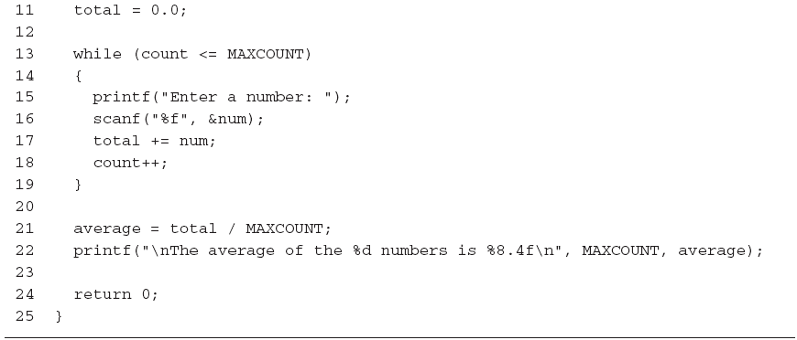
Computing Sums and Averages Using a while Loop (continued)
Calculating an average

Slide 22
Sentinels
A program, such as Program 5.7, can be made much more general by removing the restriction that exactly four numbers are to be entered
  The user enters a value for how many numbers will be averaged
  You can use a sentinel (a data value used to signal either the start or end of a data series)
    The sentinel values must be selected so as not to conflict with legitimate data values

Slide 23
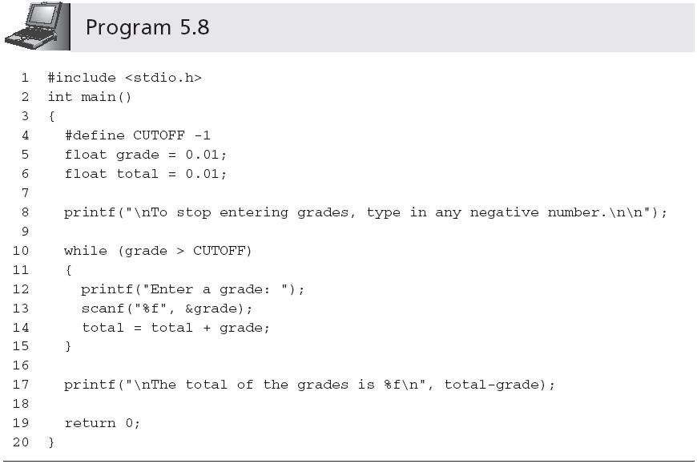
Sentinels (continued)

Slide 24
Sentinels (continued)
One useful sentinel in C is the named constant EOF (End Of File)
  The actual value of EOF is compiler-dependent, but it is always assigned a code that is not used by any other character
  EOF is defined in stdio.h

Slide 25
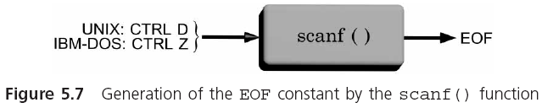
Sentinels (continued)

Slide 26
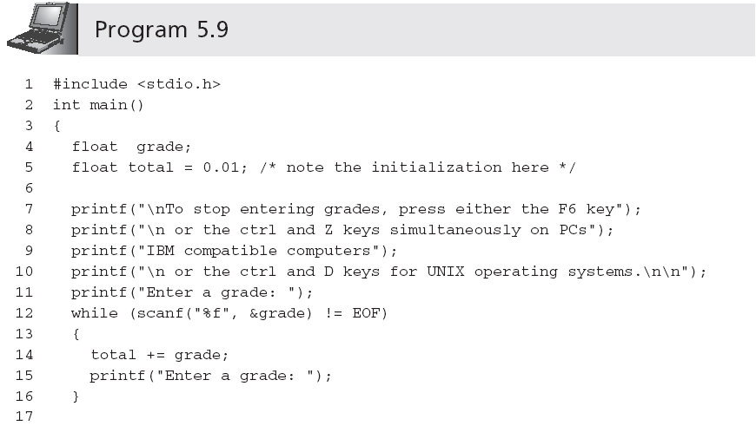
Sentinels (continued)

Slide 27
The break and continue Statements
A break forces an immediate exit from while, switch, for, and do-while statements only
    while(count <= 10)
    {
    printf("Enter a number: ");
    scanf("%f", &num);
    if (num > 76)
    {
    printf("You lose!");
    break; /* break out of the loop */
    }
    else
    printf("Keep on truckin!");
    }
    /* break jumps to here */

Slide 28
The break and continue Statements (continued)
The continue applies to loops only; when a continue statement is encountered in a loop, the next iteration of the loop begins immediately
    while (count < 30)
    {
    printf("Enter a grade: ");
    scanf("%f", &grade);
    if(grade < 0 || grade > 100)
    continue;
    total = total + grade;
    count = count + 1;
    }

Slide 29
The Null Statement
A semicolon with nothing preceding it is also a valid statement, called the null statement
  ;
Use the null statement where a statement is syntactically required, but no action is needed
Null statements typically are used either with while or for statements

Slide 30
The for Statement
The for statement combines all four elements required to easily produce a loop on the same line
  for (initializing list; tested expression; altering list)
  statement;
This statement does not require that any of the items in parentheses be present or that they actually be used for initializing or altering the values in the expression statements
  However, the two semicolons must be present
    for ( ; count <= 20;) is valid
    Omitting tested expression results in infinite loop

Slide 31
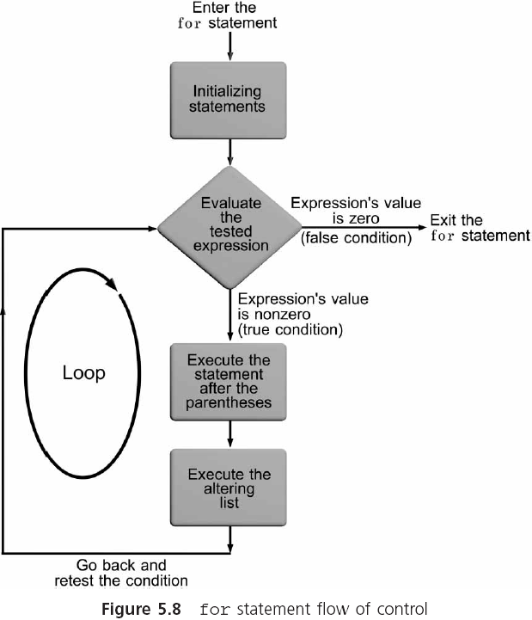
The for Statement (continued)

Slide 32
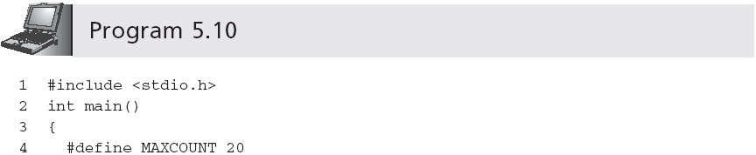
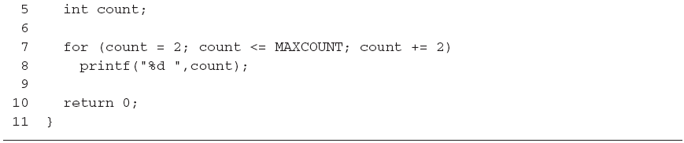
The for Statement (continued)
Output is:
  2 4 6 8 10 12 14 16 18 20

Slide 33
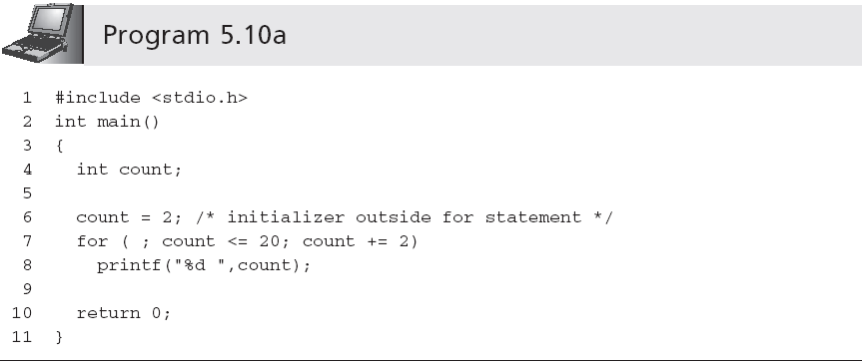
The for Statement (continued)

Slide 34
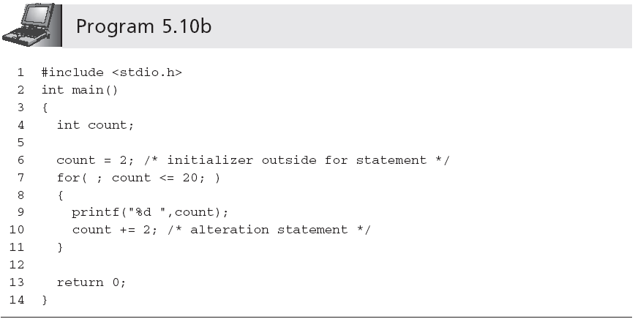
The for Statement (continued)

Slide 35
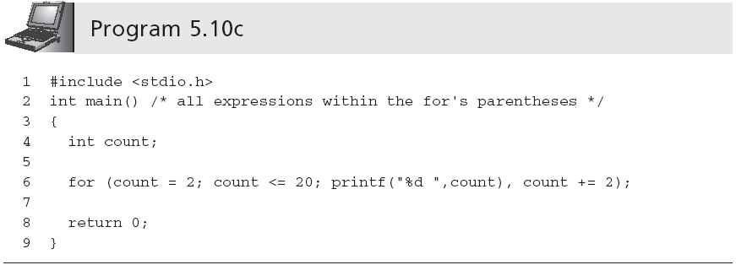
The for Statement (continued)
Comma-separated list

Slide 36
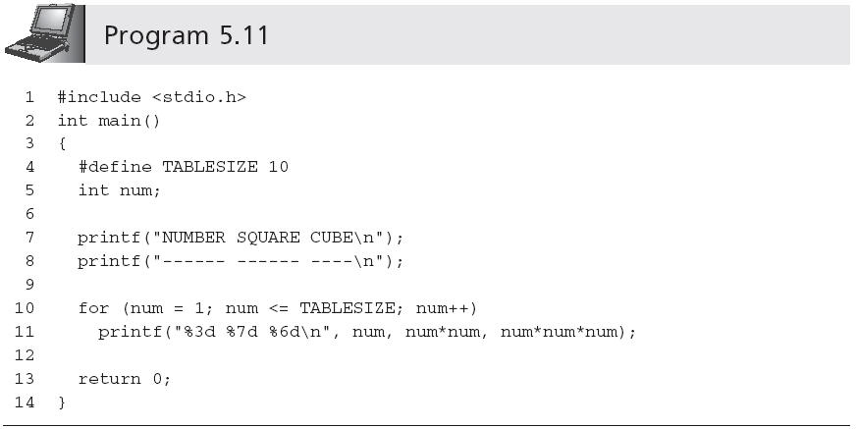
The for Statement (continued)
(compare with Program 5.3)

Slide 37
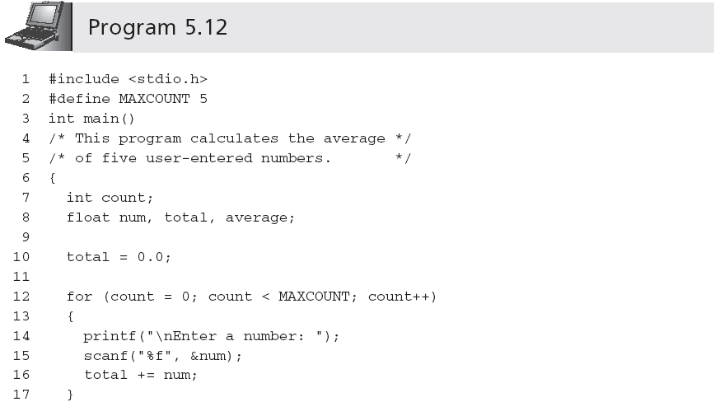
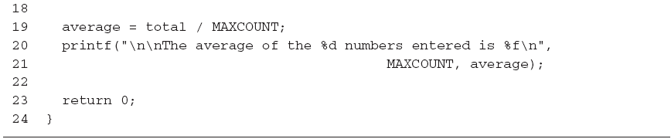
Computing Sums and Averages Using a for Loop

Slide 38
Case Studies: Loop Programming Techniques
Technique 1: Selection within a loop
Technique 2: Input data validation
Technique 3: Interactive loop control
Technique 4: Evaluating equations

Slide 39
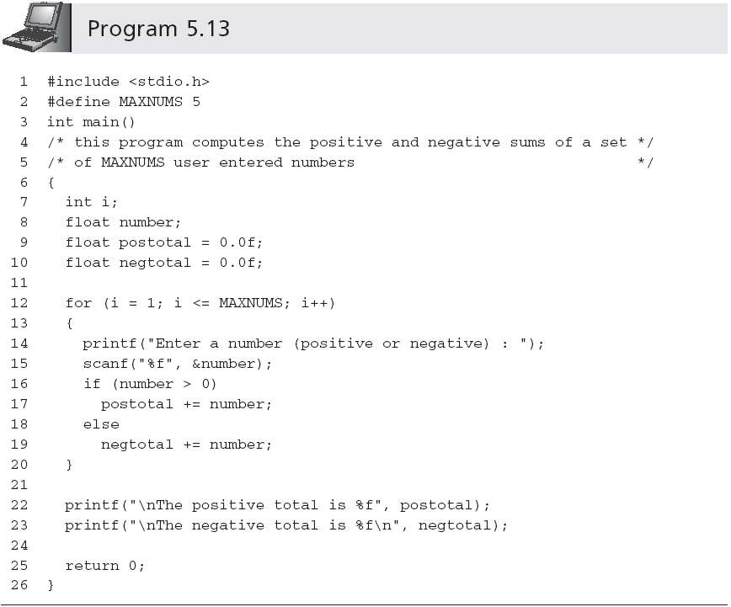
Technique 1: Selection within a Loop

Slide 40
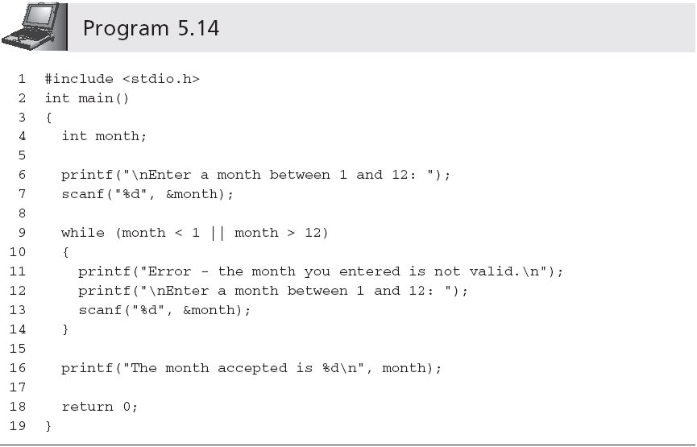
Technique 2: Input Data Validation
Same code used
in lines 6-7!

Slide 41
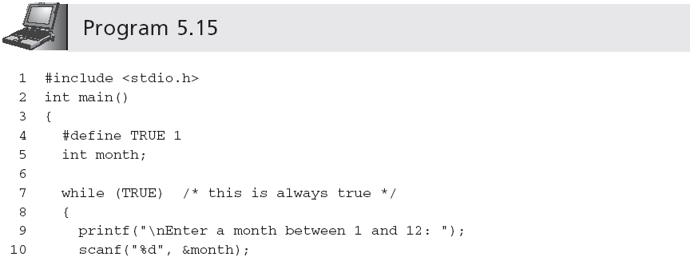
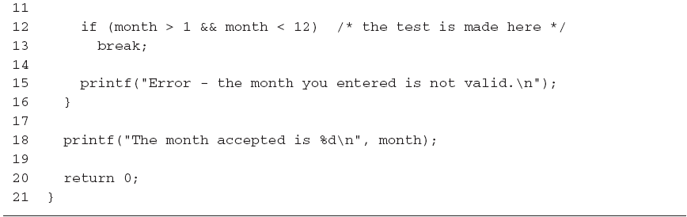
Technique 2: Input Data Validation (continued)

Slide 42
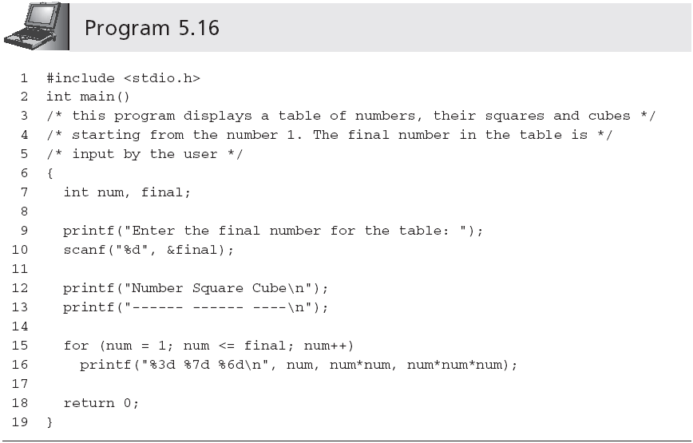
Technique 3: Interactive Loop Control

Slide 43
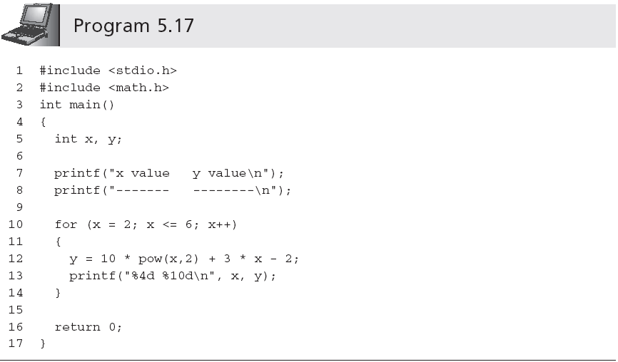
Technique 4: Evaluating Equations

Slide 44
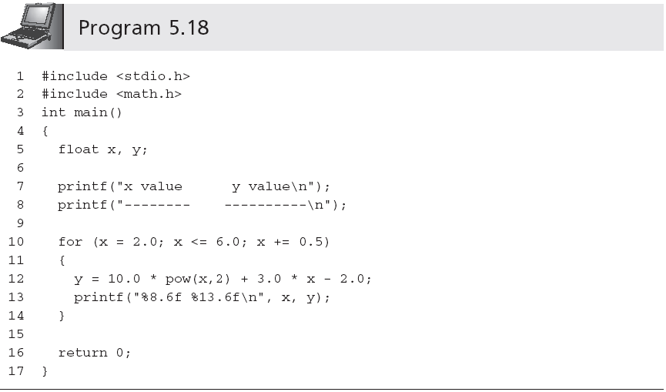
Technique 4: Evaluating Equations (continued)

Slide 45
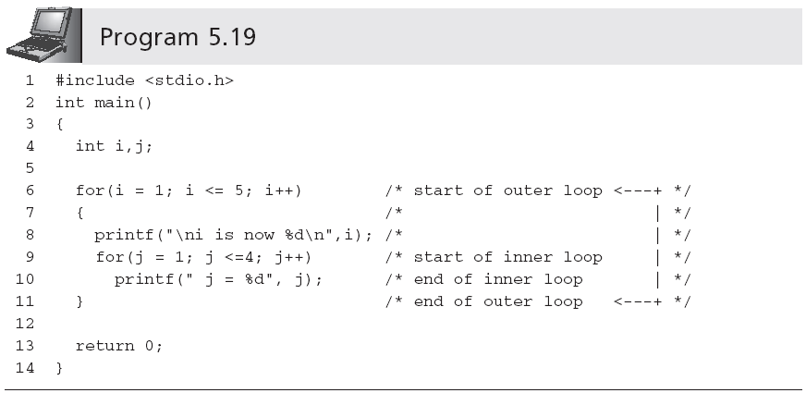
Nested Loops

Slide 46
Nested Loops (continued)
Sample run:
i is now 1
j = 1 j = 2 j = 3 j = 4
i is now 2
j = 1 j = 2 j = 3 j = 4
i is now 3
j = 1 j = 2 j = 3 j = 4
i is now 4
j = 1 j = 2 j = 3 j = 4
i is now 5
j = 1 j = 2 j = 3 j = 4

Slide 47
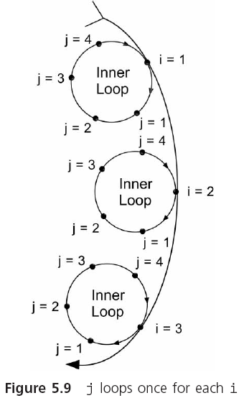
Nested Loops (continued)

Slide 48
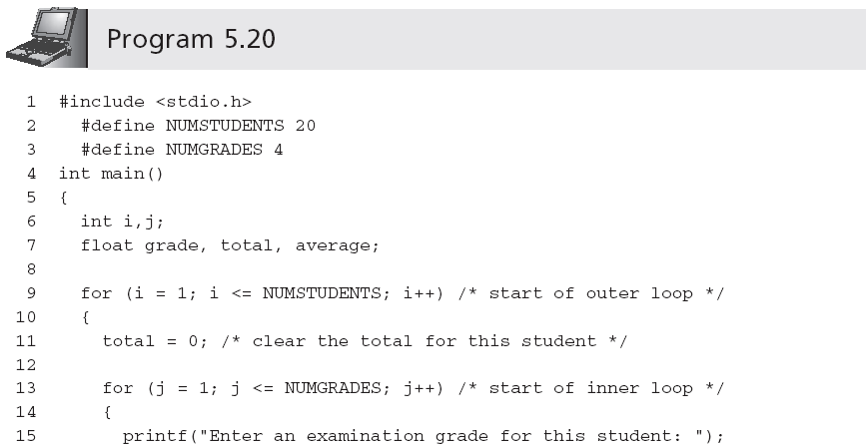
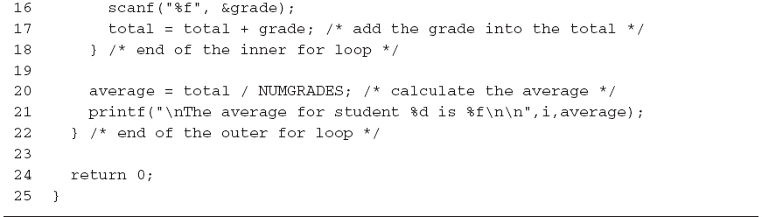
Nested Loops (continued)

Slide 49
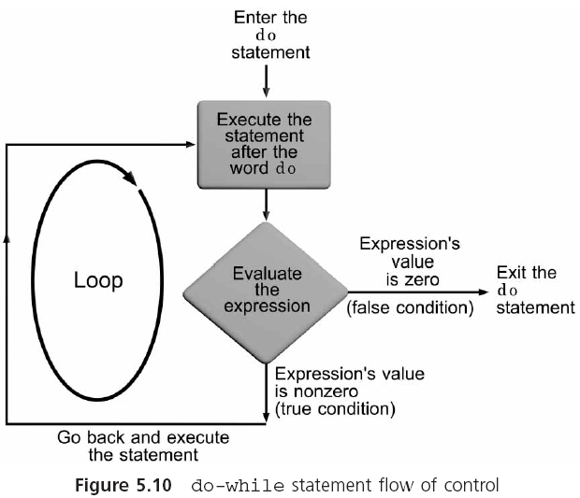
The do-while Statement

Slide 50
The do-while Statement (continued)
The general form of the do statement is
    do
    statement;
    while (expression);
do-while is a posttest loop
One type of application is ideally suited for a posttest loop:
  Input data validation application

Slide 51
The do-while Statement (continued)
do
{
printf("\nEnter an ID number: ");
scanf("%f", &idNum);
} while (idNum < 1000 || idNum > 1999);

Slide 52
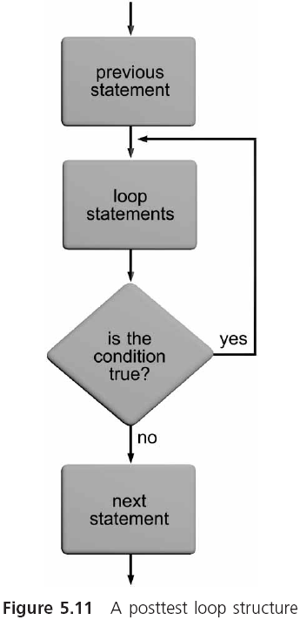
The do-while Statement (continued)

Slide 53
Common Programming Errors
“Off by one” error, in which the loop executes either one too many or one too few times than intended
Using the assignment operator, =, instead of the equality operator, ==, in the tested expression
As with the if statement, repetition statements should not use the equality operator, ==, when testing single-precision or double-precision operands

Slide 54
Common Programming Errors (continued)
Placing a semicolon at the end of the for’s parentheses (creates a do-nothing loop)
Using commas to separate the items in a for statement instead of the required semicolons
Omitting the final semicolon from the do statement

Slide 55
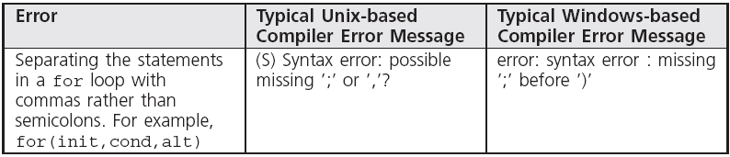
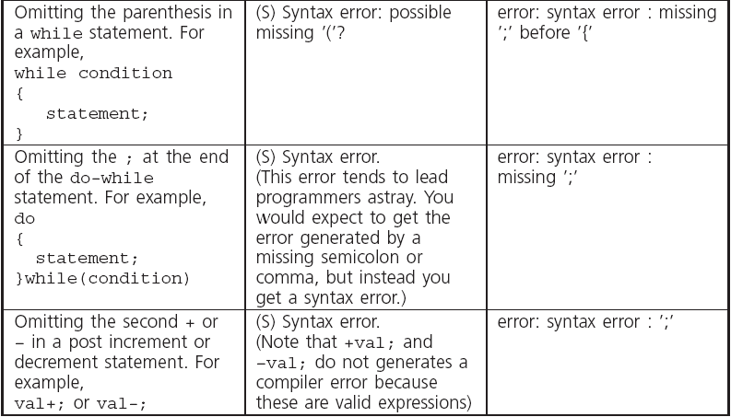
Common Compiler Errors

Slide 56
Summary
A section of repeating code is called a loop
The three C repetition statements are while, for and do-while
Loops are also classified as to the type of tested condition
The most commonly used syntax for a while loop is
    while (expression)
    {
    statements;
    }

Slide 57
Summary (continued)
A for statement performs the same functions as the while statement, but uses a different form
The for statement is extremely useful in creating counter-controlled loops
The do-while statement is used to create posttest loops because it checks its expression at the end of the loop

